Slide 1
Welcome to
Meadows First School -
a brief tour of the school

Slide 2
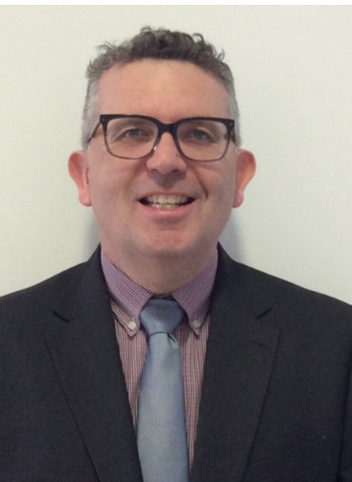
Mr Satchwell and Mrs Dwyer would like to welcome you to Meadows First School. This is short presentation for you to watch if you are thinking of joining our school.
Mr Satchwell is the head teacher
Mrs Dwyer is the deputy head teacher
https://www.meadowsfirst.co.uk/parents/starting-school-new-admissions

Slide 3
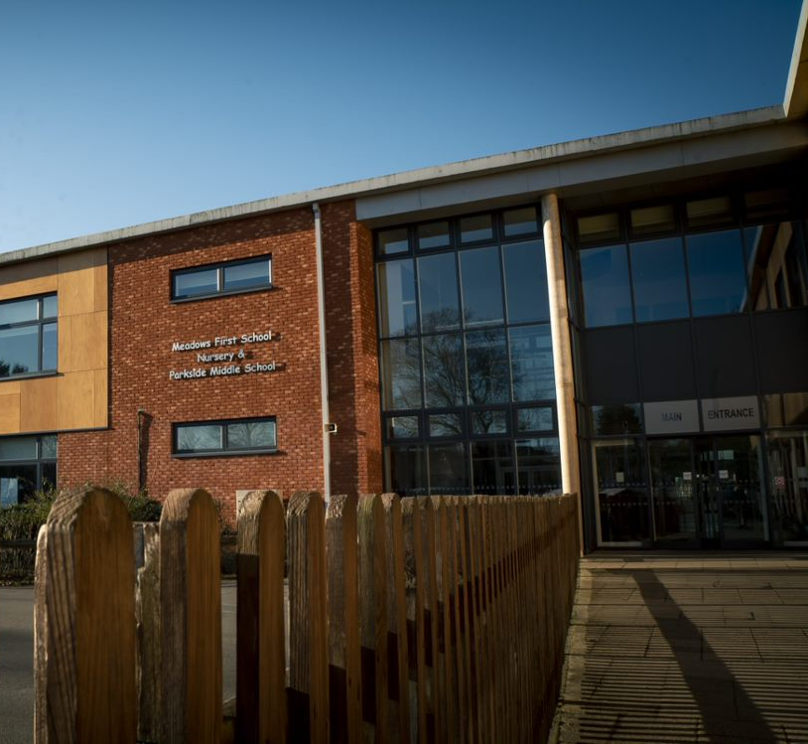
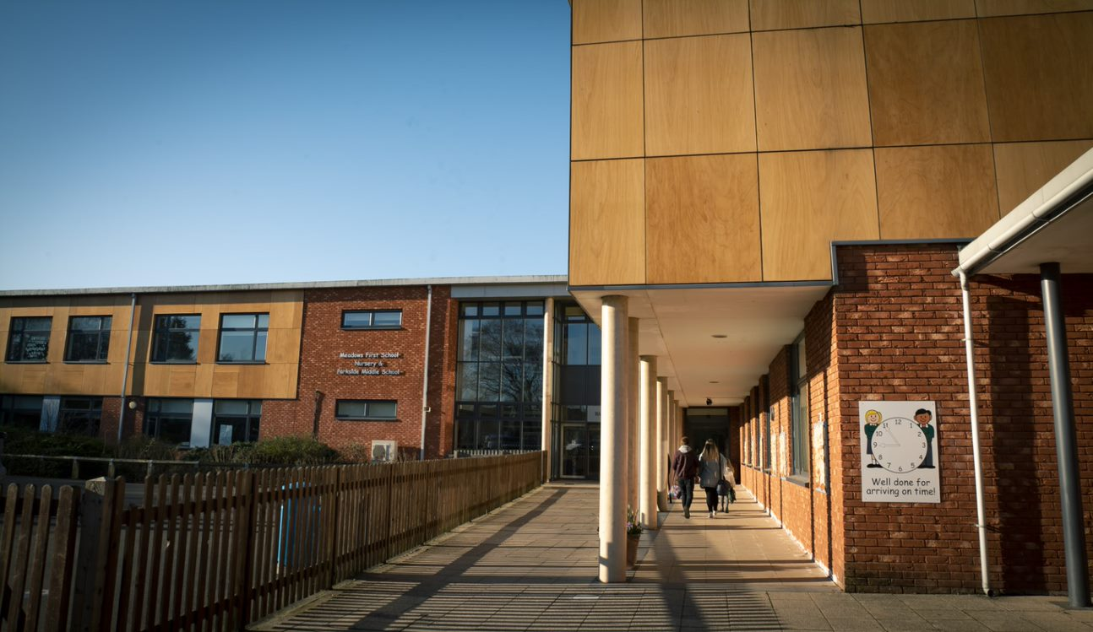
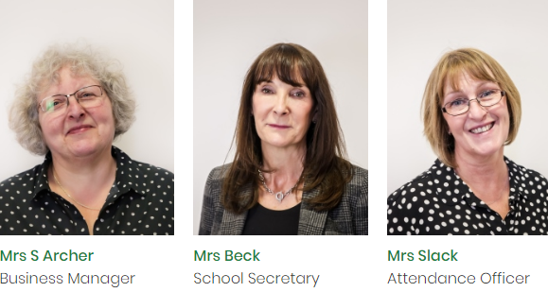
Email: office@meadows.worcs.sch.uk or phone: 01527 872508

Slide 4
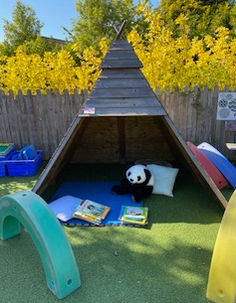
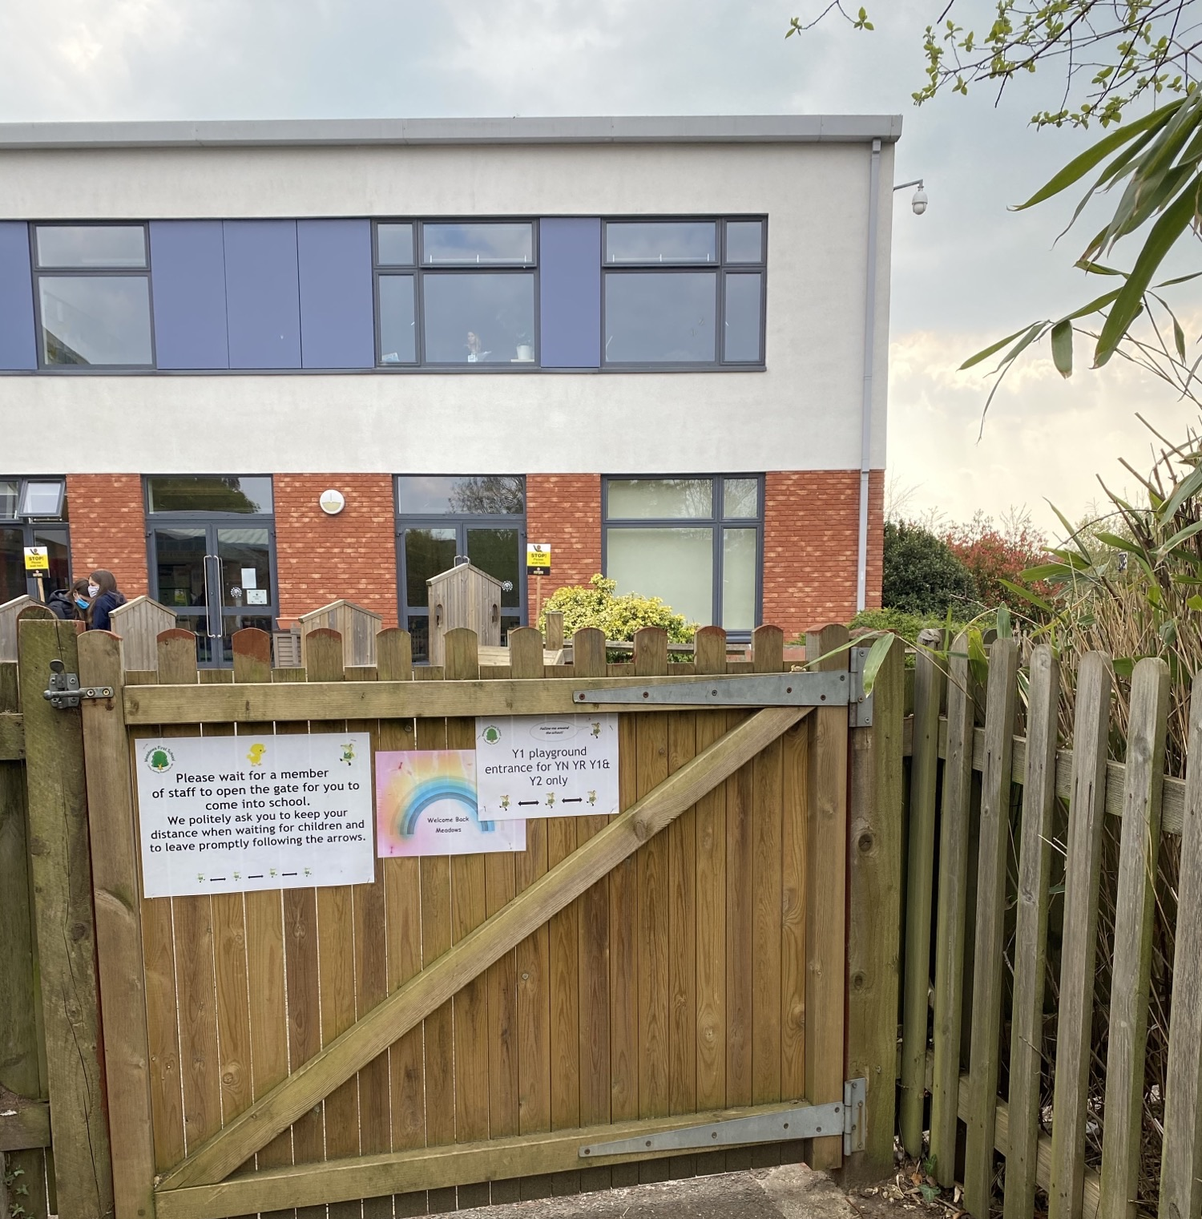
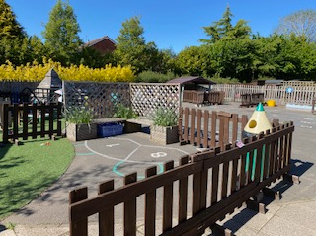
Reception
This is the entrance to the Year 1 playground and reception classes. (This playground is where Reception, Year 1 and year 2 are dropped off each day)
This is the Reception outside learning area.

Slide 5
Reception
Photos of class teachers coming soon for 24-25 intake!
The 2 reception classes are Cygnets and Goslings. These are the class teachers and staff to support your children when they start school.
Notes:
.

Slide 6
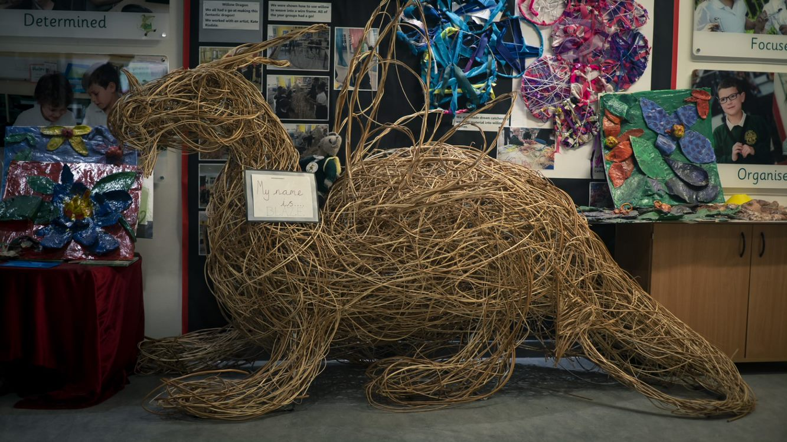
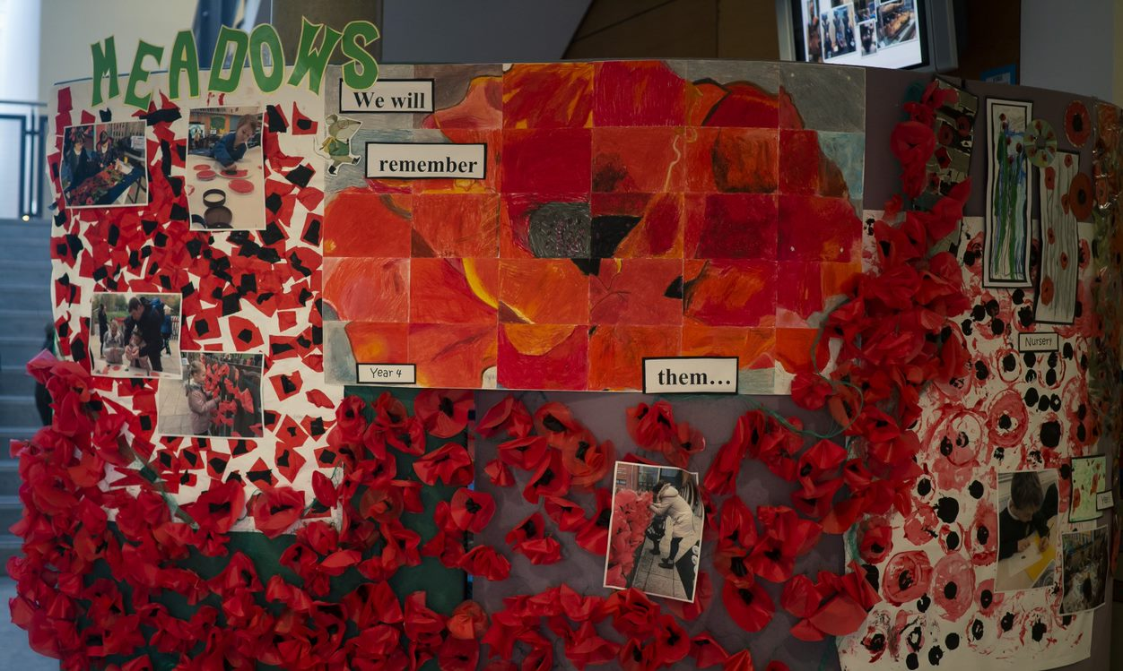
A short tour of the school….
We are very proud of our school; we are a gold arts mark school!
We have lots of visiting artists that come and work with our children on exciting projects.

Slide 7
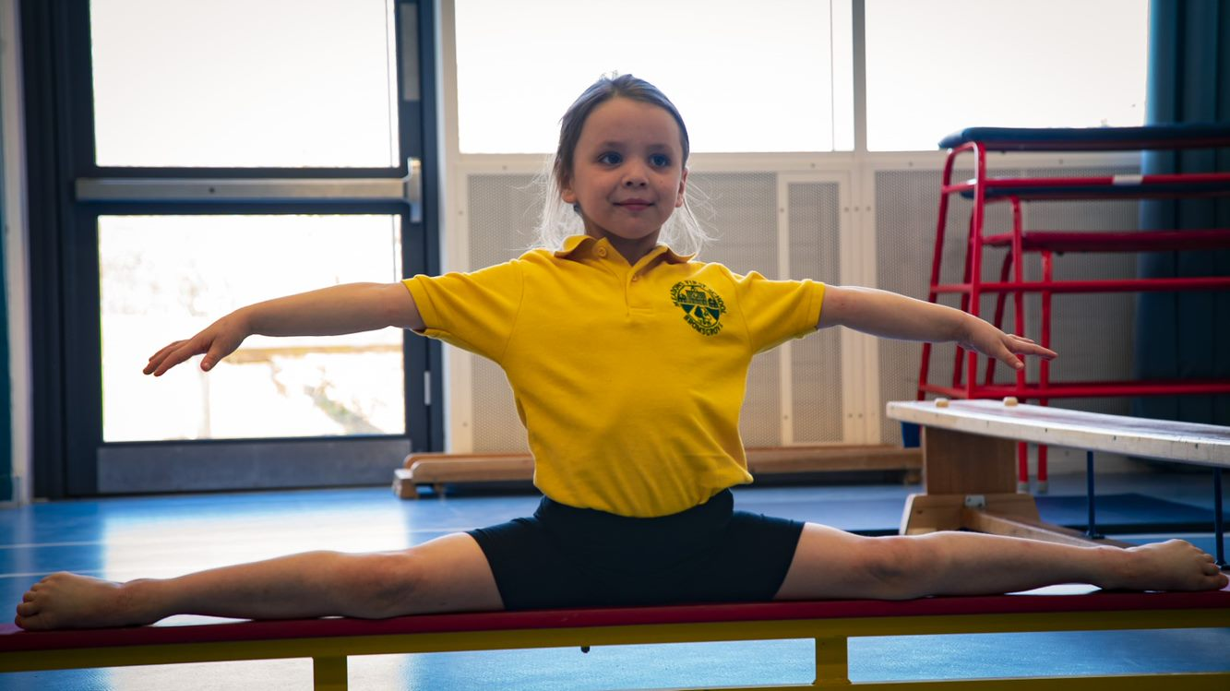
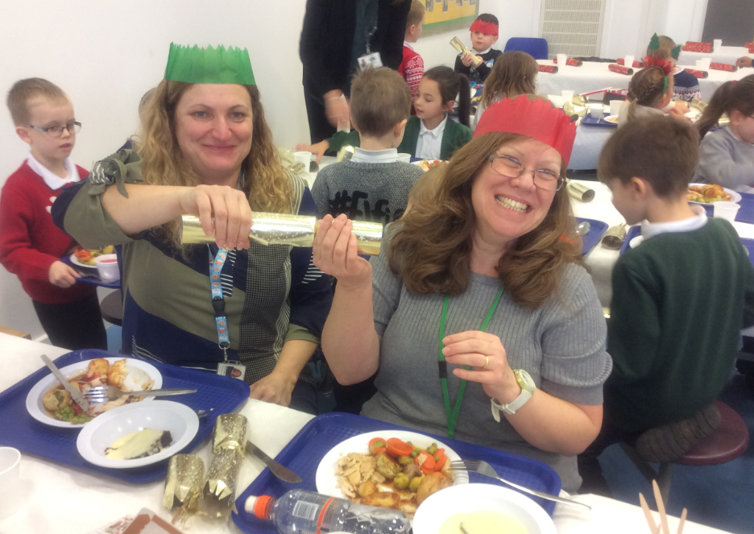
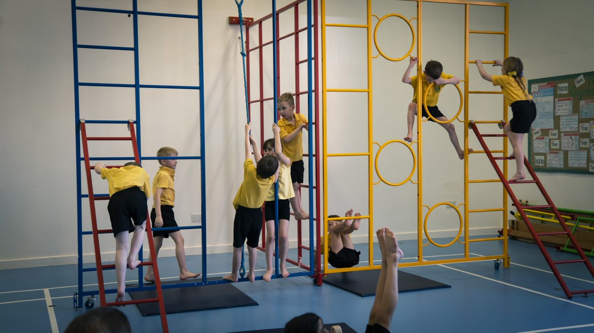
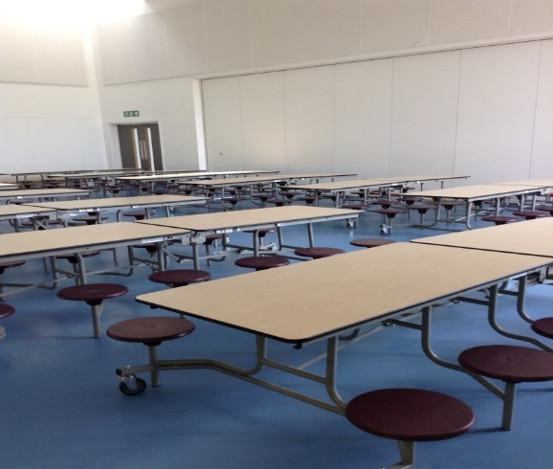
Our halls and gym….
We have a gym and a dance hall too!
This is where we eat our lunch!

Slide 8
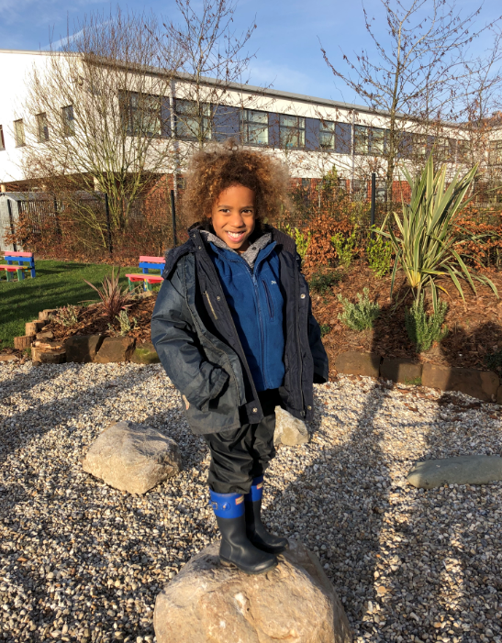
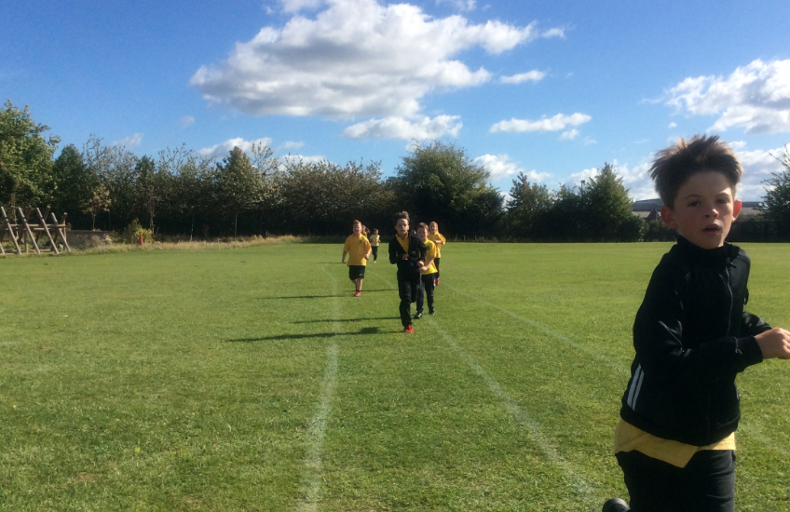
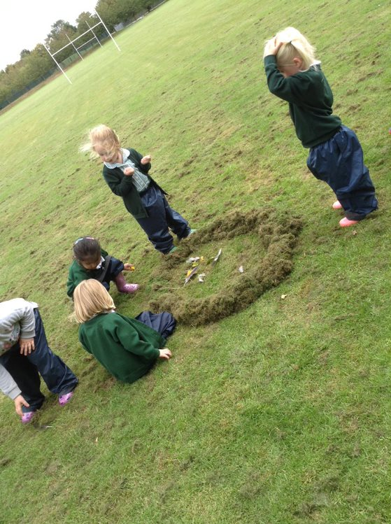
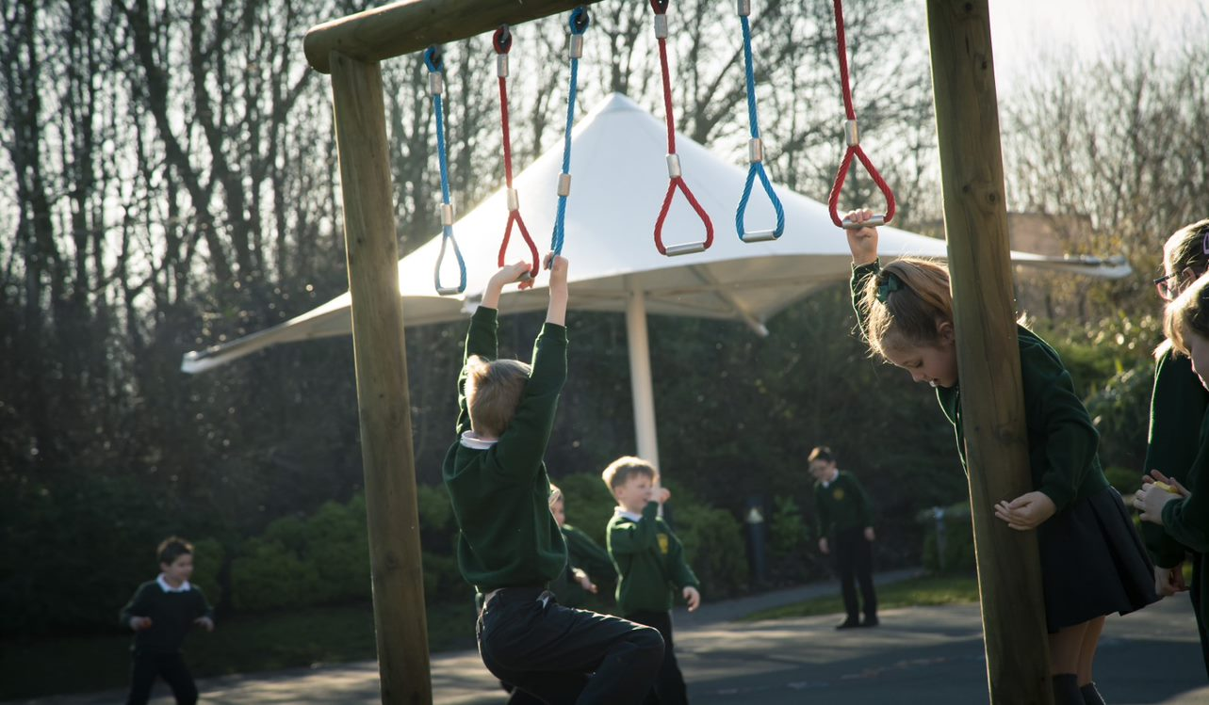
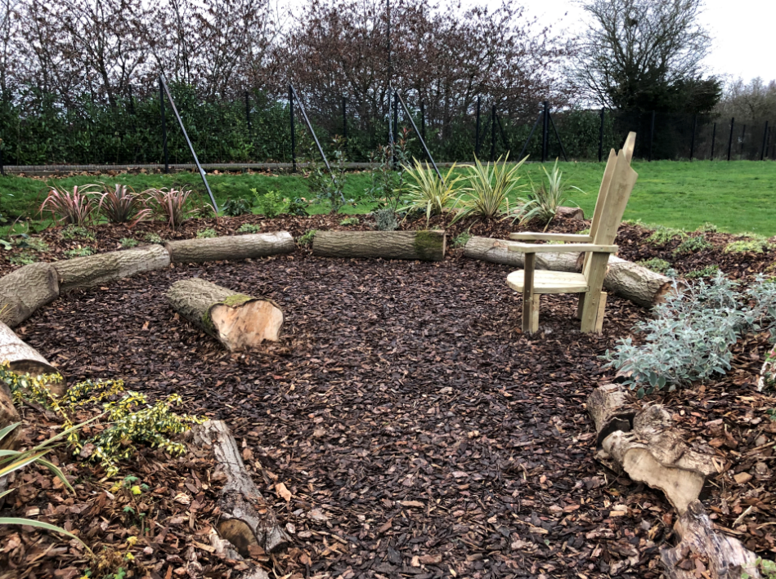
Our outside spaces….
We are lucky to have so much outside space, which we use to support outside learning.
As well as our 4 playgrounds, we have 3 forest school sites a large playing field an allotment and a pond and a wellbeing garden!
Notes:
(Mrs Dwyer): outside learning is very important to us as at school. The children in early years have weekly forest school sessions and all of the children use the playing fields for PE and for activities such as orienteering and sports events. The pond and the allotments are also used in some lessons and we now have a well being garden which the children designed and are still in the process of developing. We hold termly ‘empty classroom days’ to get the children out and about in the school grounds too.

Slide 9
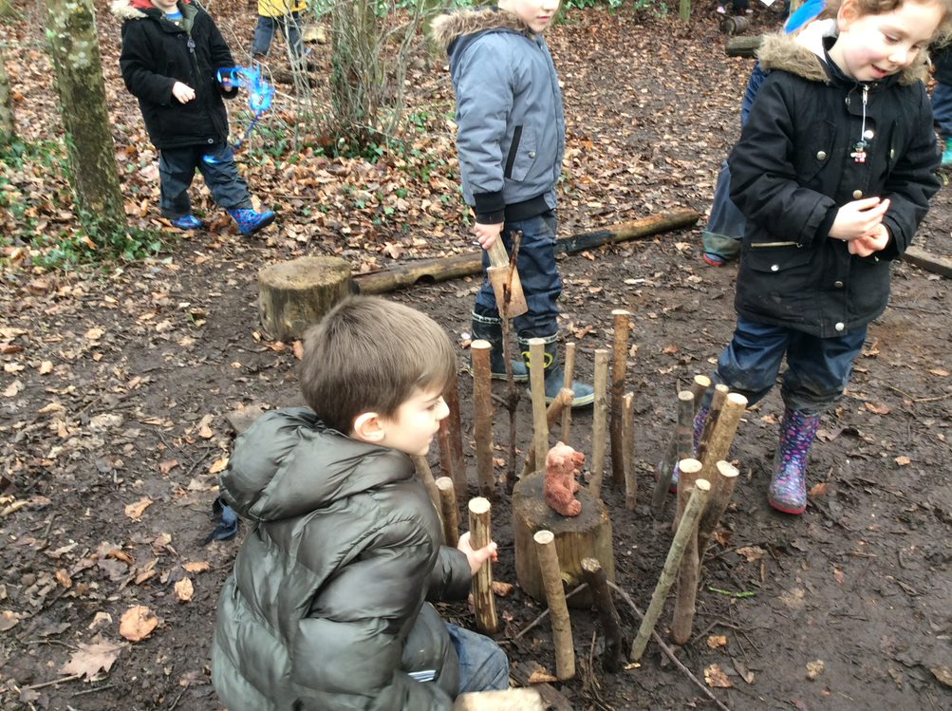
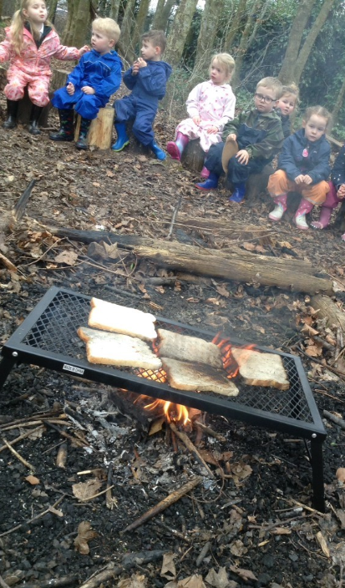
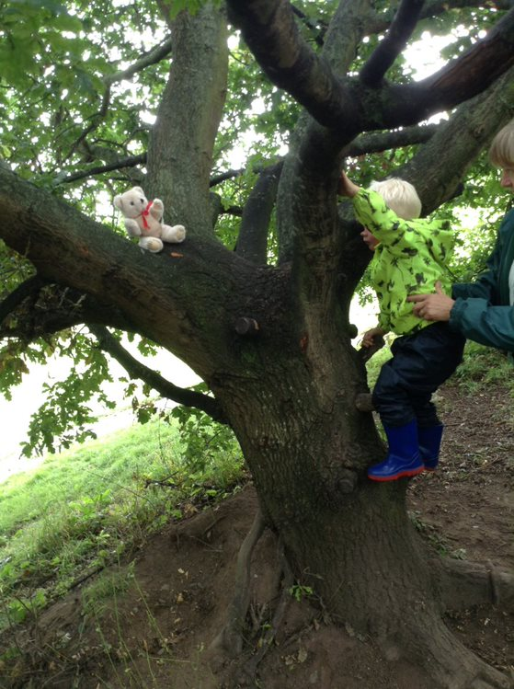
Forest school activities are held weekly for children in both Nursery and Reception. Other classes use these sites as part of their outdoor learning too.

Slide 10
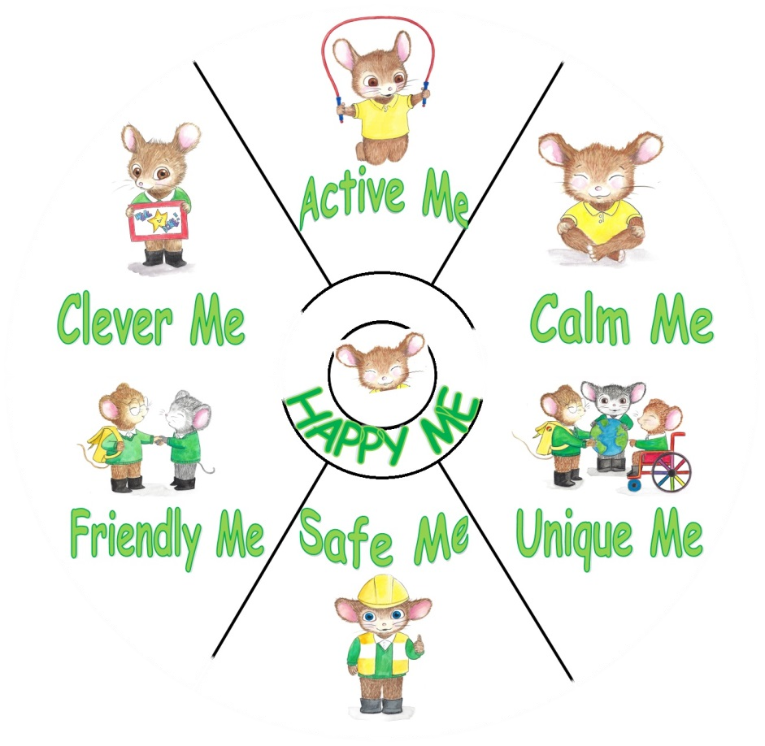
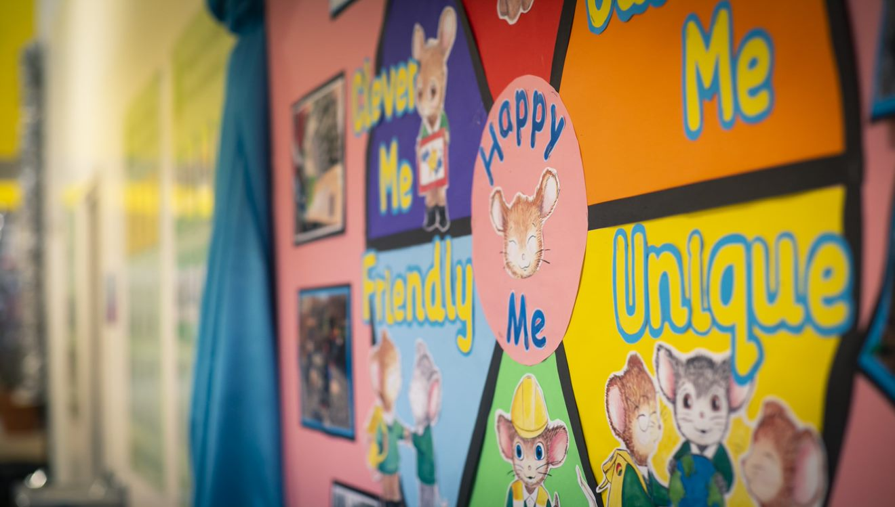
My name is Meadows Mouse. I help you around school too!
Wellbeing of everyone is very important. We designed a wellbeing wheel to help us with this.
We are a Gold Rights Respecting School

Slide 11
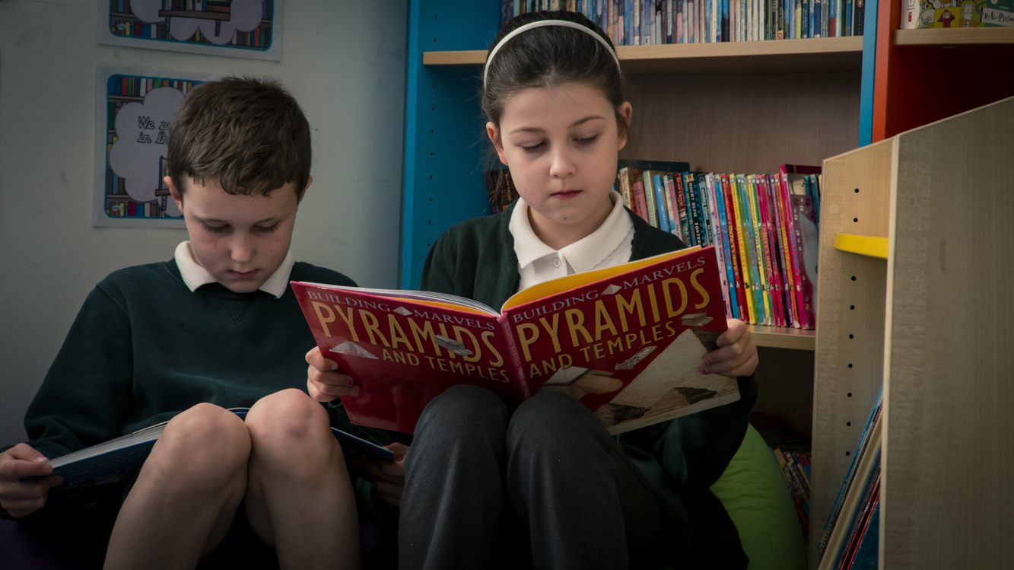
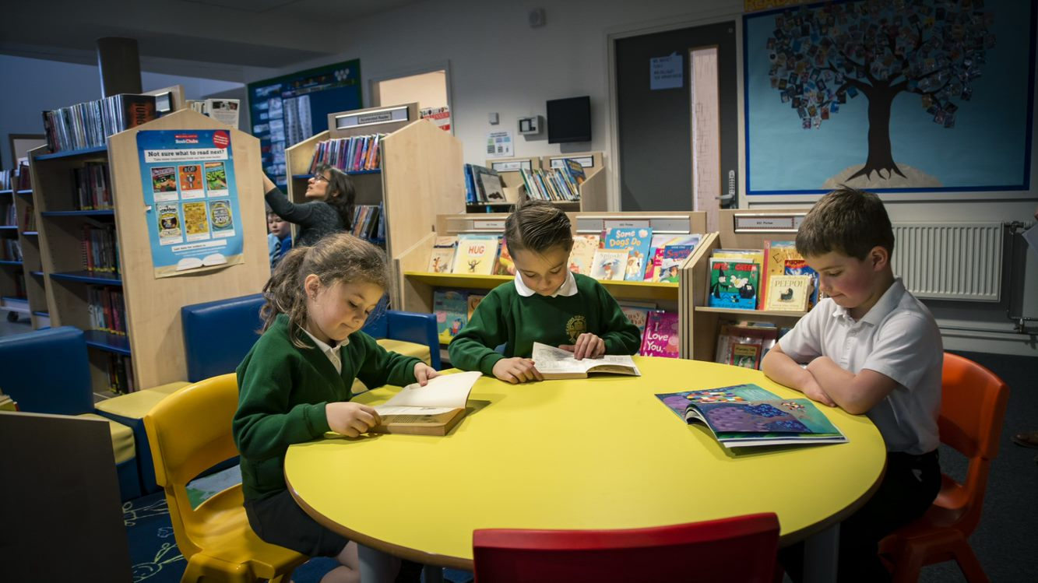
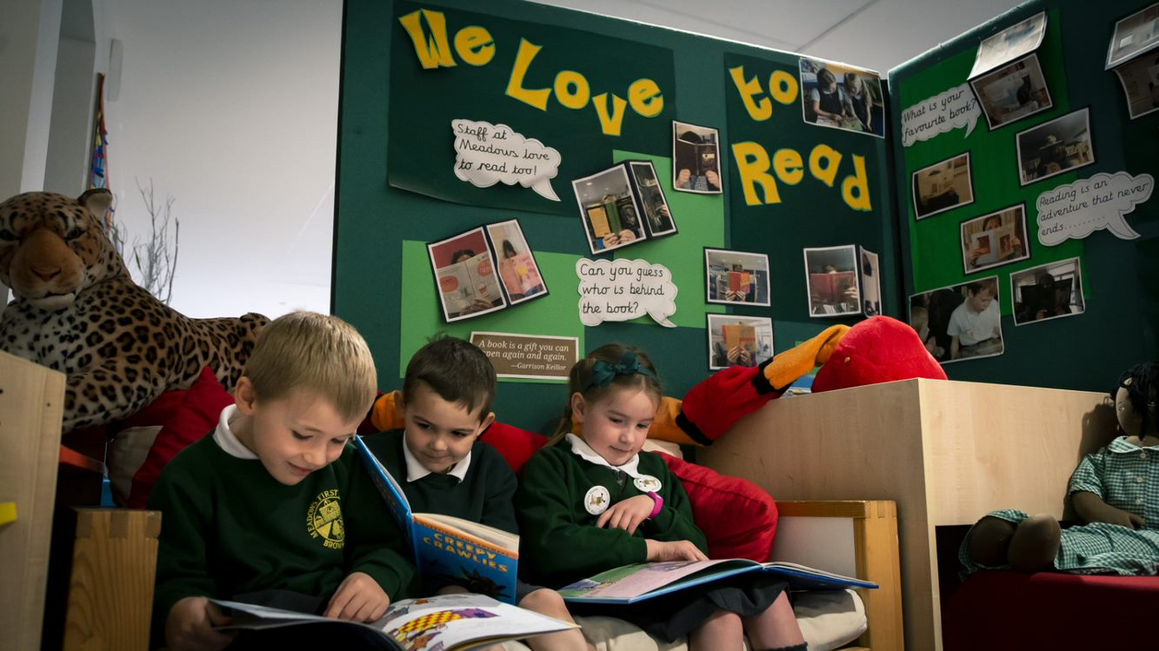
Reading….
We are so excited to have a brand new library!
Reading is a core priority – our children love to read!

Slide 12
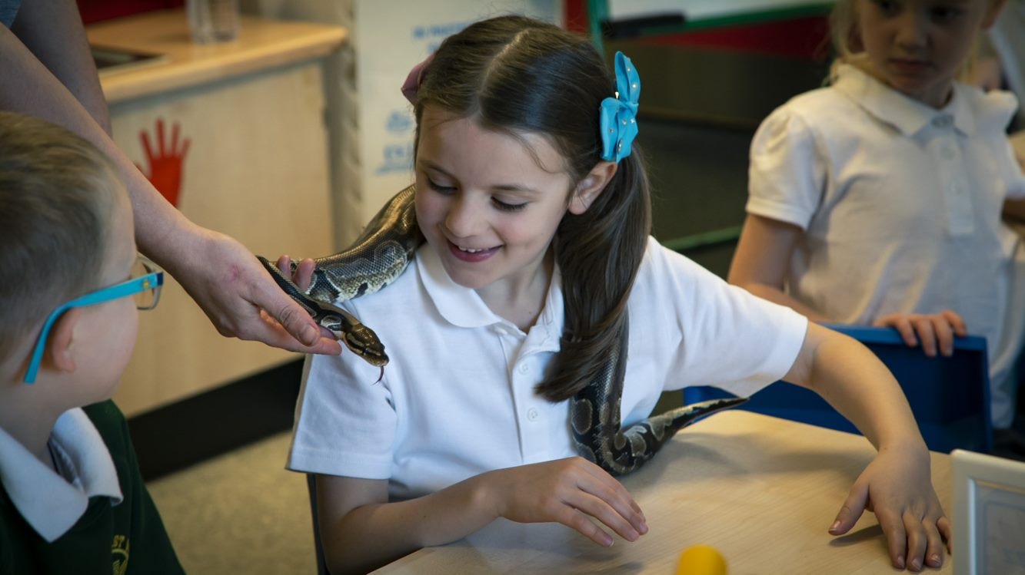
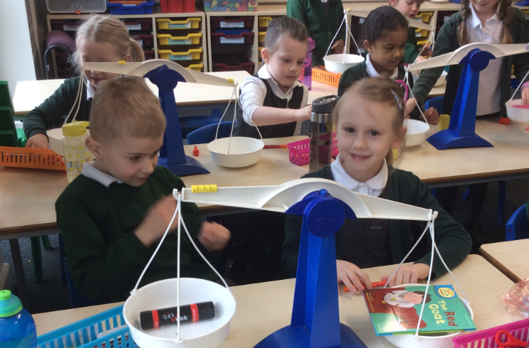
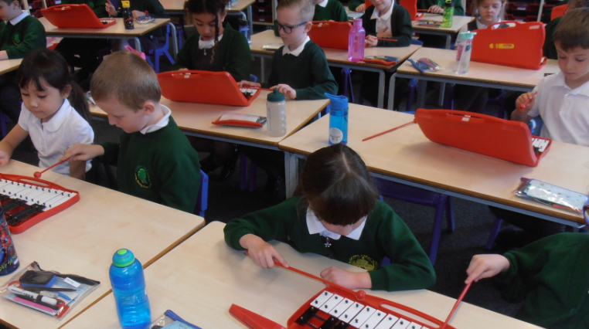
Our classes….
Our school is made up of 11 classes – from Nursery (Ducklings) up to Year 4 (Jaguars and Tigers). Each class has 30 children.
The Foundation Stage (Nursery and Reception) along with Key Stage 1 (year 1 and 2) are in classes on the ground floor. Key stage 2 classes (year 3 and year 4) are all upstairs.
We also have a Mainstream Autism Base (the Den) which is County run and is for children with specific ASD needs. We do not allocate places for this unit. These specialist provision places are allocated by County.
https://www.meadowsfirst.co.uk/our-school/year-by-year

Slide 13
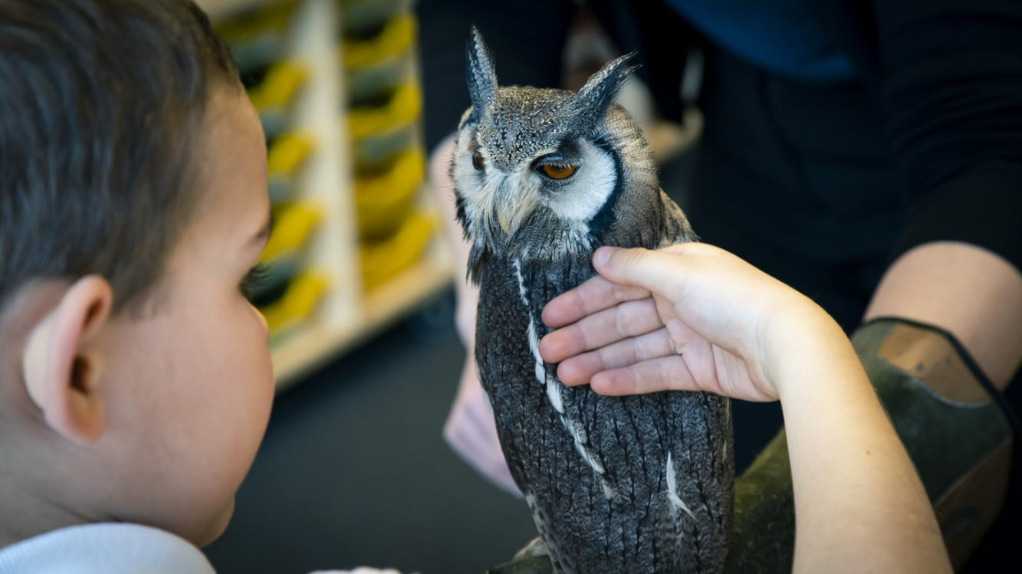
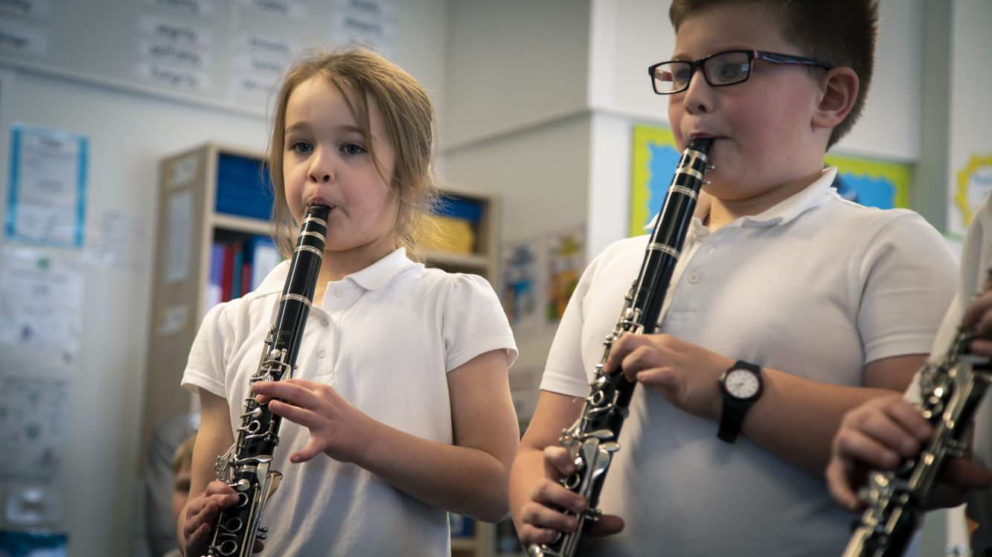
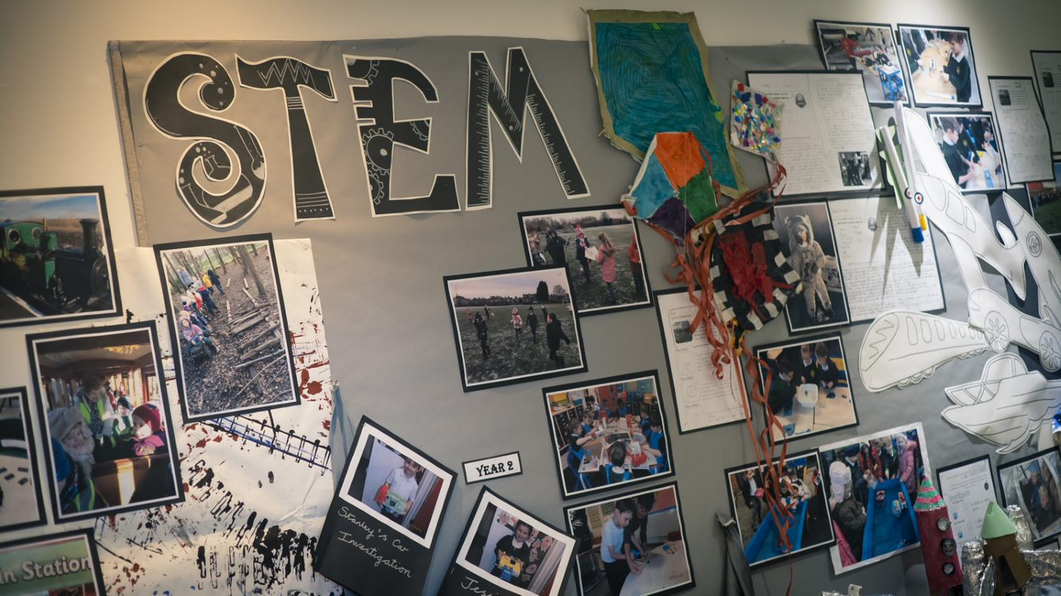
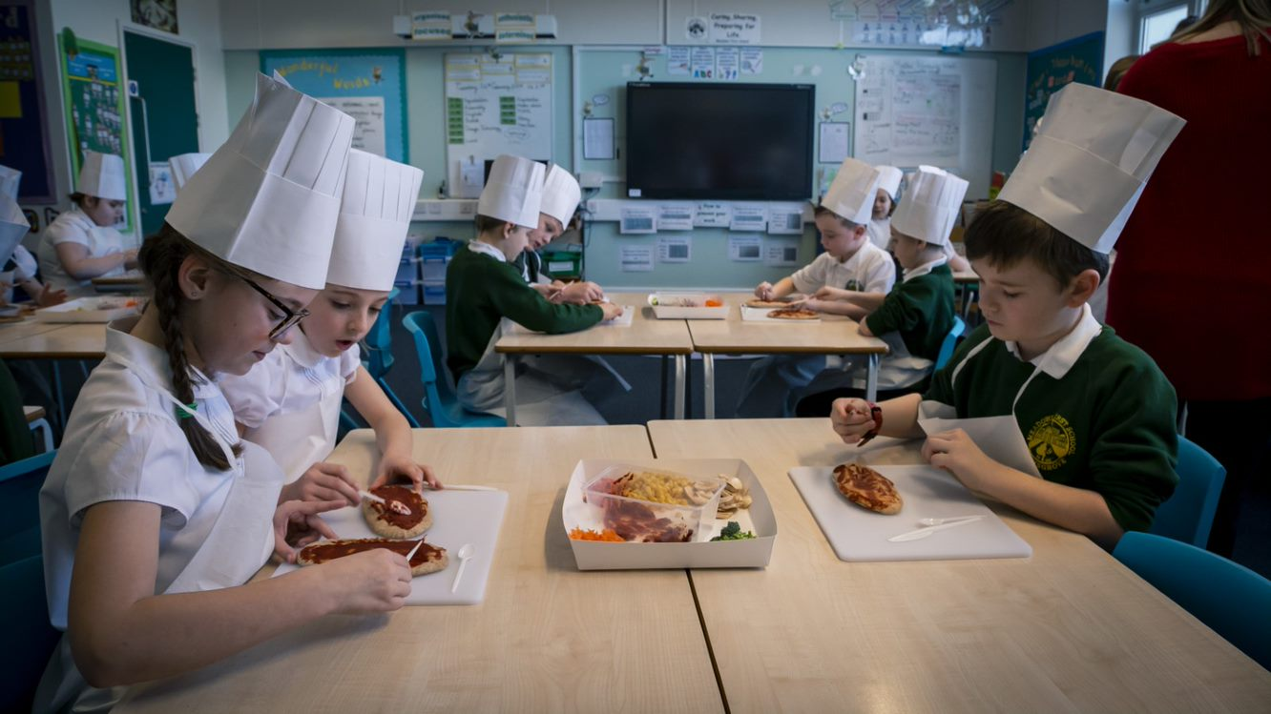
This is our school motto. We want children to have rich opportunities to help prepare them for their next step.
Caring, sharing, preparing for life…
We develop a respect for each other and the world around us.

Slide 14
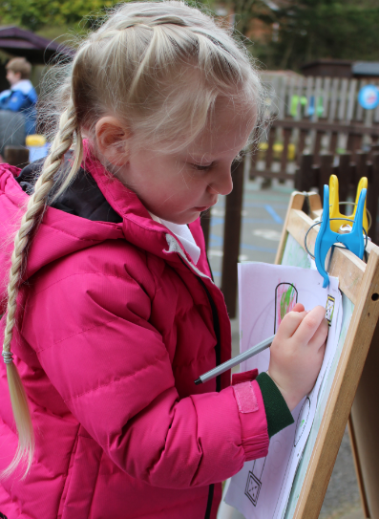
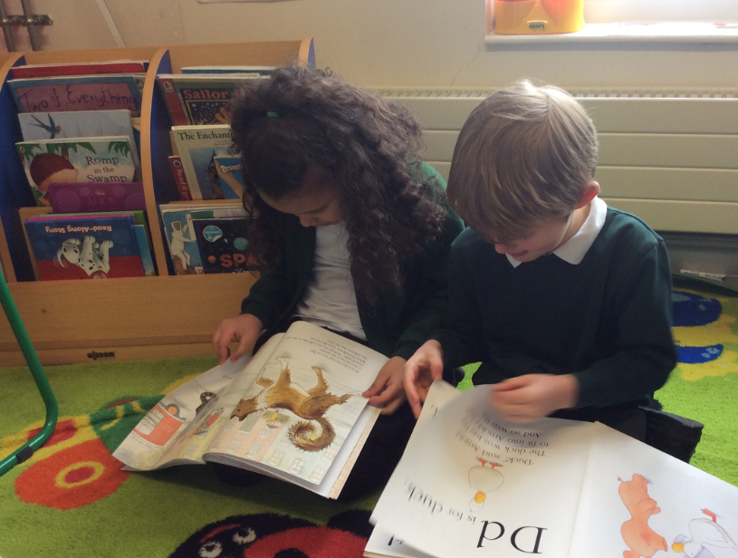
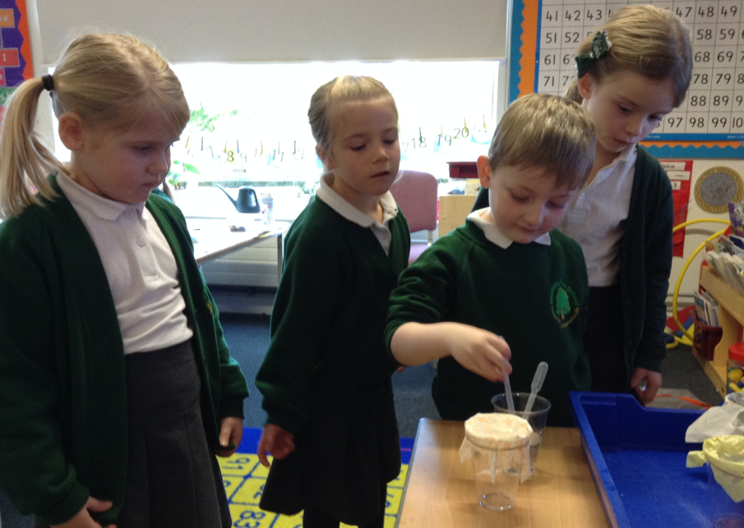
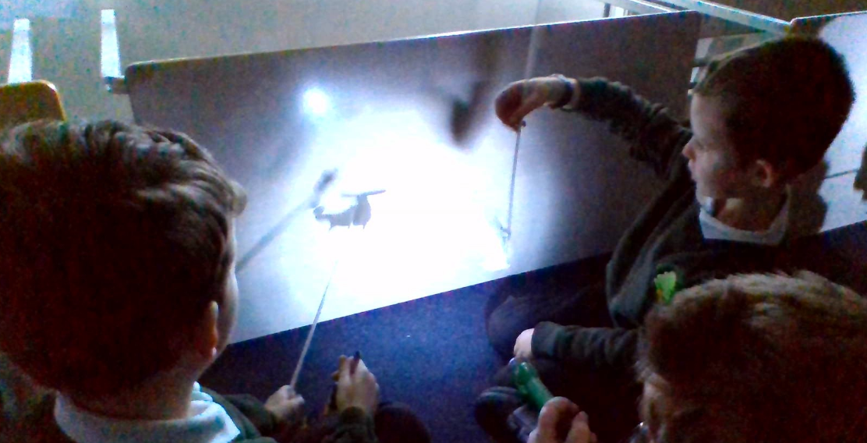
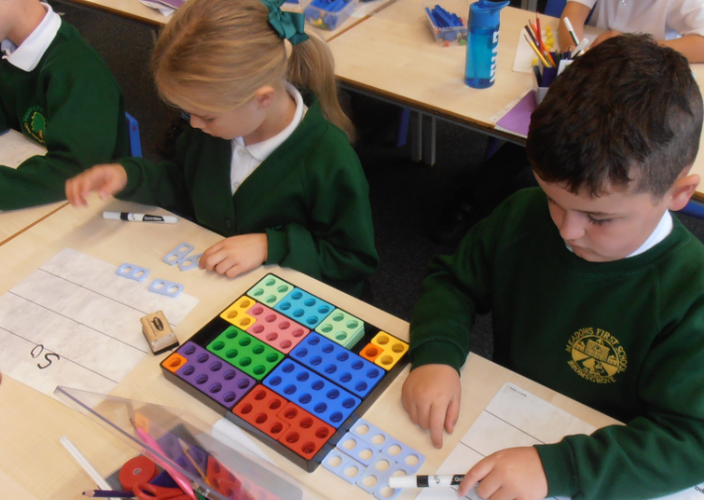
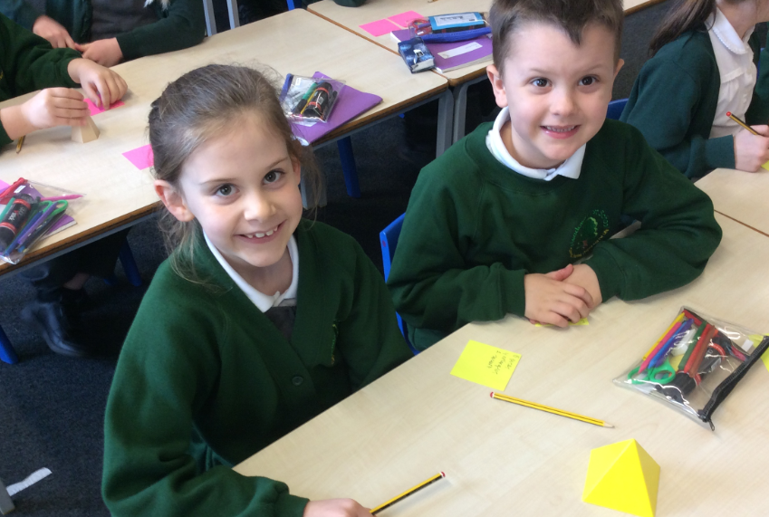
We make learning come to life and be memorable for our children.

Slide 15
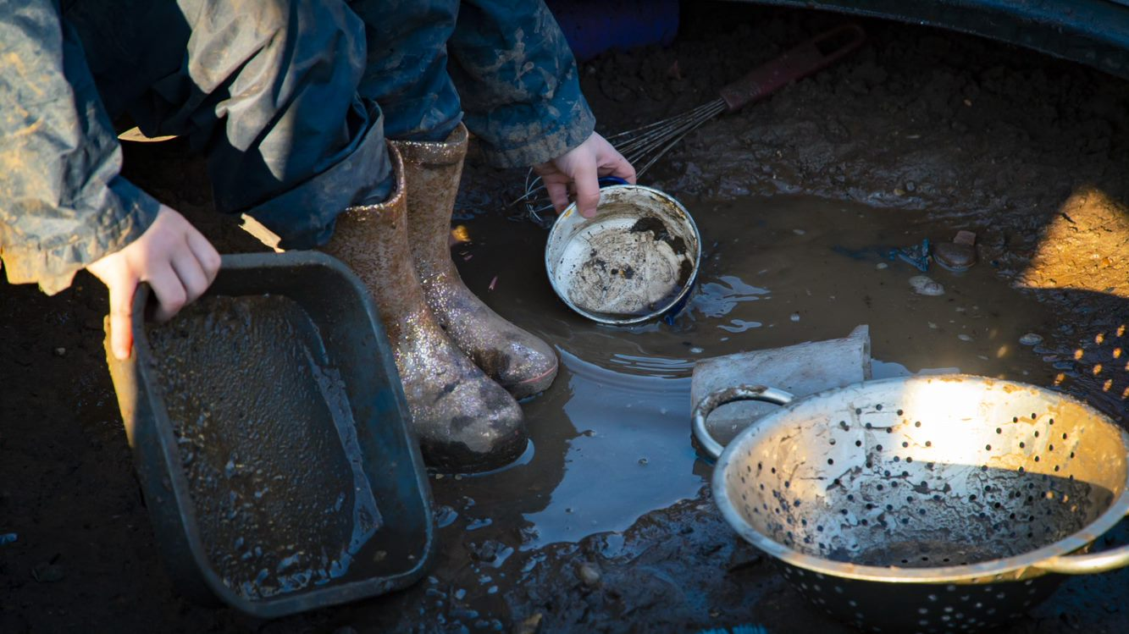
We want children to take risks and learn about how to keep themselves safe.
Notes:
No notes – just click

Slide 16
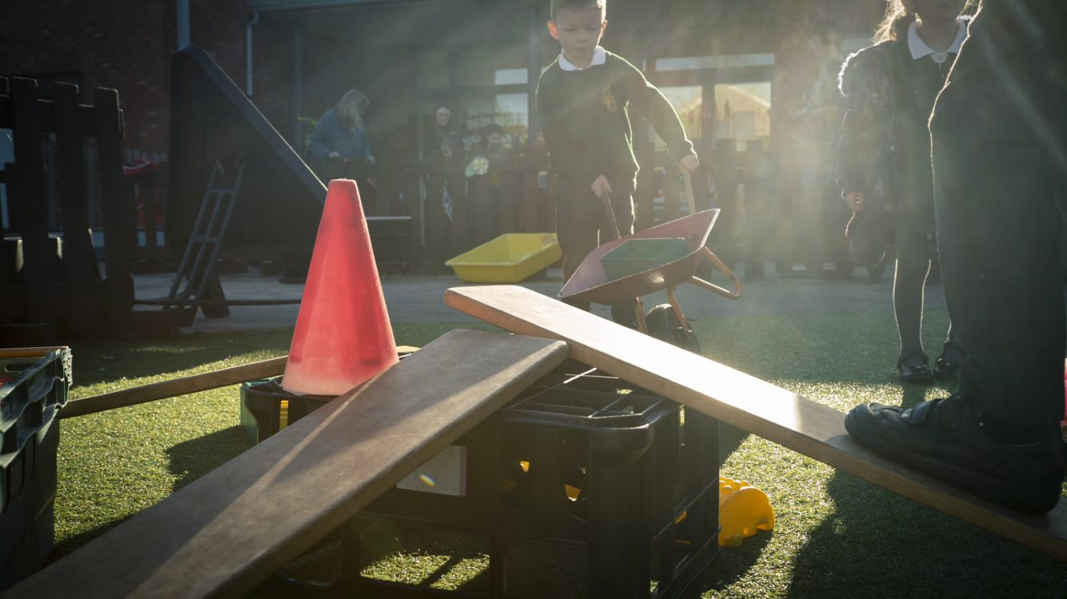
We learn how to get along and share.
Notes:
No notes – just click

Slide 17
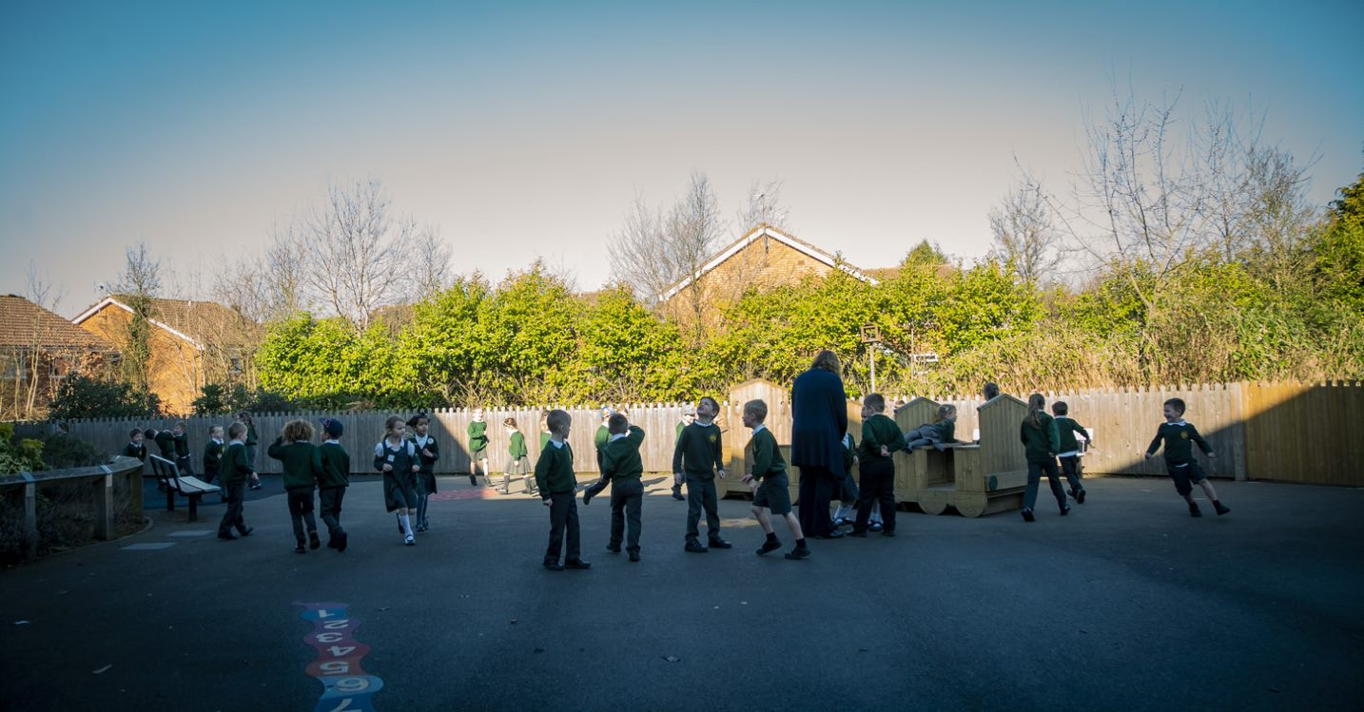
https://www.meadowsfirst.co.uk/parents/starting-school-new-admissions
We are kind to each and know how to be a good friend.

Slide 18
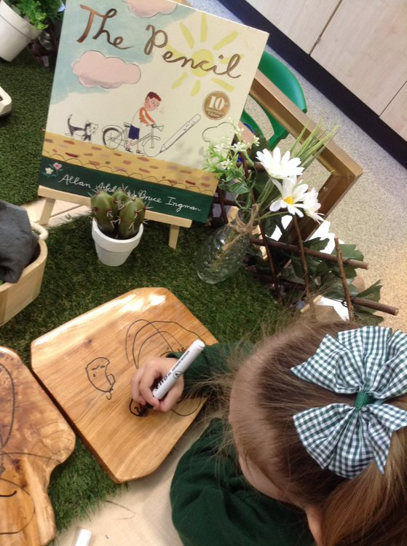
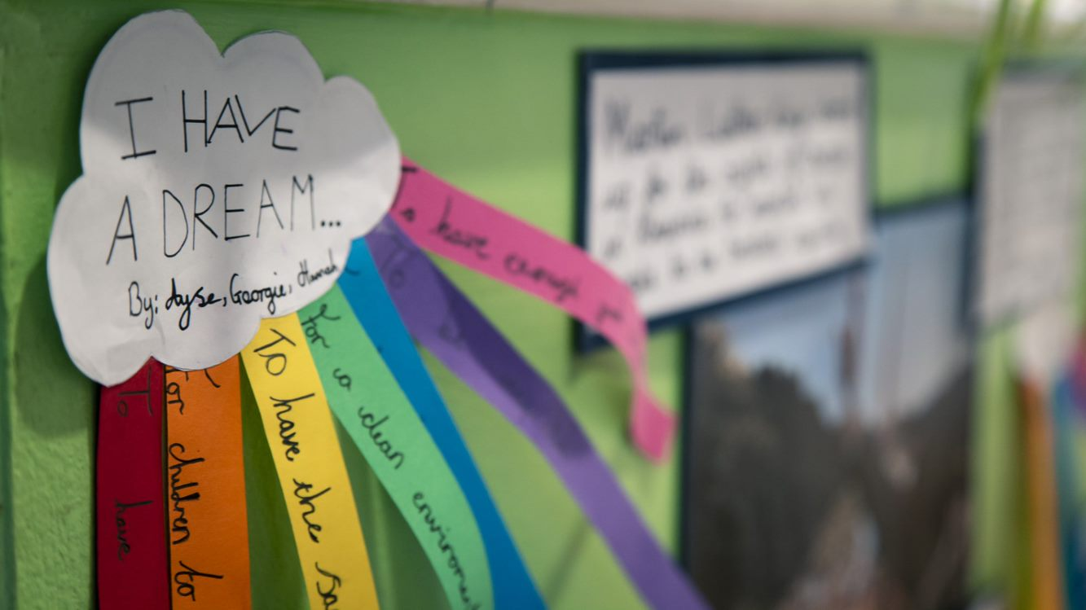
Thank you for watching – we hope to see you soon!

